Slide 1
COMMUNICATION SKILLS
UNIT CODE: MED/CU/HSS/BC/01/4/A
By:
Ms. Faith Nandasaba

Slide 2

Introduction
Getting to know one another.
Notes:
Two Truths & A Lie
To allow participants to get to know and appreciate one another better, through discovering both
common and unique interests and experiences. To help level the playing field within a group
through making human connections that aren’t related to either organizational or power structures.
To help people begin to be more comfortable talking and listening with one another.
Instructions:
1. Tell participants that they must introduce themselves to the group, coming up with two true
statements/facts about themselves and one lie.
2. Ask for a volunteer to start with their two truths and a lie – have them share all three with the
group.
3. Whoever guesses the correct lie, will go next.
4. Some participants may want to expand on their truth statements, depending upon how
elaborate they are!

Slide 3
Unit Overview
Definition of terms
Types of communication
Mode and Medium of communication
Flow of Information
Principles of communication
Essentials of effective communication(7Cs of communication)

Slide 4
Unit Overview
Types of Communication
Barriers of Effective Communication
Listening & note taking skills
Reading skills
Speaking and presentation skills
Writing skills

Slide 5
Unit Overview
Workplace Etiquette
Lead workplace discussion
Identify and communicate issues arising in the workplace

Slide 6
Purpose of the unit
To equip learners with soft skills
To develop the learners’ 4 language skills; i.e. reading, writing, speaking and listening
To apply the knowledge acquired for personal and professional development

Slide 7
Summary of Learning Outcomes
1. Obtain and convey workplace information
2. Complete relevant work-related documents
3. Communicate information about workplace processes
4. Lead workplace discussion
5. Identify and communicate issues arising in the workplace

Slide 8
Lesson Objectives
By the end of this session trainees should be able to;
Distinguish between communication and communication skills.
Describe the communication process
List and explain barriers to effective communication
Practice active listening
Implement tips on how to improve verbal and non verbal communication

Slide 9

What is Communication?
Communication is a dynamic process by which meaning is exchanged between individuals or an individual and a group through a common system; speech, visuals, signals, writing or behavior.
Communication is not a mysterious process. It takes place when the ideas from your mind are transferred to another’s and arrive intact, complete, and coherent.

Slide 10
Communication Goals
To change behavior
To get action
To ensure understanding
To persuade
To get and give information

Slide 11
Importance of communication
Activity- Paper chains game

Slide 12
What is communication skills?
Set of skills that enable a person to convey information so that it is clearly received and understood.
The ability to speak in public, write reports, chair meeting etc.

Slide 13
Elements of communication
Sender: This is the source/ generator of information and initiator of communication
Encoder: Means translating the message.
Medium: Is the channel used to communicate the message.
Receiver: The group or individual who receives the message.
Decoding : The receiver perceives and interprets or decodes the sender’s message into information that has meaning.
Feedback: Is a continuous two way process.

Slide 14
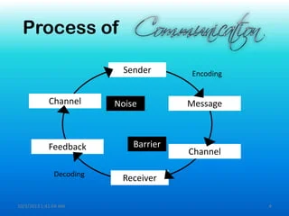
Communication Process

Slide 15

“This is a pen”
Notes:
“This is a pen “

Slide 16
Mode of Communication
Verbal Communication
Written communication
Non-verbal communication
Visual communication
Listening communication

Slide 17



Features of Effective Communication
Active listening
Eye contact
Good posture
Simple language
Questioning skills

Slide 18

Benefits of effective communication
Quicker problem solving
Better decision making
Steady work flow
Strong business relations
Better professional image

Slide 19
Types of communication
On the basis of organization relationship
Formal
Informal
On the basis of flow
Vertical
Diagonal
Horizontal
On the basis of expression
Oral
Written
Body language

Slide 20

Broken telephone exercise
Notes:
Split your group into two even lines. At opposite ends of each line, say this “A guppy in a shark tank” to the person on the end and tell them to pass it on using only whispers, one person at a time. They can only repeat the phrase or sentence once.
While participants are busy passing the message along to the next person in line, play music or engage them in conversation to create some white noise. This will make it a bit more difficult but it will mimic real-life conditions, where distractions abound.
When the messages have made it to the end of each line, have the last person to receive the message in each line report out on what they heard. Next, have the first person to receive the message in each line report the original message and compare it to the final message received.

Slide 21
Barriers to Communication
Semantic Barriers
Emotional or Psychological Barriers
Organizational Barriers
Barriers in superiors

Slide 22
Semantic Barriers
Symbols with different meaning
Badly expressed message
Faulty translation
Unclarified assumption
Specialist’s language

Slide 23
Emotional/ Psychological Barriers
Premature evolution
Inattention
Poor retention
Undue reliance on the written word
Distrust
Failure to communicate

Slide 24
Organization Barriers
Organizational policy
Organization rules and regulation
Status relation
Complexity in organization

Slide 25
Personal Barriers
Attitude in superior
Lack of awareness
Lack of time
Fear of challenge of authority
Attitude of superior
Barriers in sub-ordinates
Unwillingness to communicate
Lack of proper incentive

Slide 26



Barriers to effective communication
1. Physical barrier
2. Language barrier
3. Cultural barrier
4. Emotional barrier
5. Individual barrier
6. Lack of Subject Knowledge
7. Stress
8. Attitudinal barrier
9. Channel barrier

Slide 27
How to overcome barriers
Overcome Perception
Effective Listening
Create Synergistic Environment
Convey Emotional Contents of the Message
Use Appropriate Language
Use Proper Channel
Encourage Open Communication
Ensure Two – Way Communication
Best Use of Body Language
Have Clarity, Brevity and Accuracy

Slide 28
Review Questions
Explain the process of communication
Discuss the barriers to effective communication
Highlight features of effective communicative

Slide 29

Stop Listening Exercise
Active listening activity
Notes:
Split your group into two smaller groups of equal size and take one group outside the room. Tell them that they are instructed to stop listening to their partner after about 30 seconds, and to be open in showing their disinterest. Tell the other group to think of something that they are passionate about and be prepared to tell their soon-to-be partner a meaningful or personally relevant story about this topic.
Bring the other group back in, put all the participants into pairs, and tell them to get started. Observe the behavior from the listeners and the reactions from the speakers until you’re sure each speaker has picked up on what’s happening. Stop the conversations at this point and explain the instructions that were given to each group.
Facilitate a group discussion on the importance of listening, how to use active listening, and what indicates that someone is truly listening

Slide 30
Hearing Vs Listening
Hearing –Reaction of nervous system, no concentration
Listening – Physical & mental process of receiving sounds, attach meaning and respond.
Listening is hard.
You must choose to participate in the process of listening.

Slide 31

Active Listening
The process of recognizing, understanding, and
accurately interpreting communicated messages
and responding to spoken and/or nonverbal
messages.

Slide 32
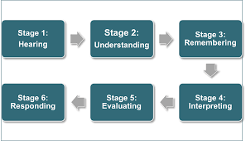
Listening Process/ steps

Slide 33
Barriers of Listening
Listening too hard
Psychological factors
Physical factors
Semantic factors
Biological/physiological factors

Slide 34
Improving Listening Skills
Setting goals
Block out destructions
Suspend judgement
Focus on main points
Recognize highlights & signposts
Note taking
Paraphrasing
Questioning

Slide 35

Blind Drawing Game
Learning how to navigate gaps in understanding and listen more carefully to what other people are saying is the objective of the game.
Notes:
Ask trainees get a piece of paper, a pen, stand up and close their eyes. Describe an object in abstract terms as they draw. When done let them open their eyes and exchange their drawing with someone next to them. Critique the images as a class.
Ask trainees what they would do to improve their drawing next rime.

Slide 36

7Cs of effective communication
ACTIVITY- Groupwork
In reference to the handouts, discuss & identify a badly written message and a good example.
Notes:
Ask participants to sit in groups of 4s and distribute the 7Cs handouts. Allow them 10 minutes to discuss and do presentations.

Slide 37
7 Cs of Effective Communication?
Clear.
Concise.
Concrete.
Correct.
Coherent.
Complete.
Courteous

Slide 38
Review Questions
Distinguish between listening and hearing
Discuss the listening process
Describe the techniques used to improve listening skills

Slide 39
Improving Verbal Communication-Tips
Eliminate Noise
Get Feedback – Verbal & Body Signals
Speak Slowly & Rephrase your sentence
Don’t Talk down to the other person
Avoid use of jargons
Listen Carefully & Patiently

Slide 40
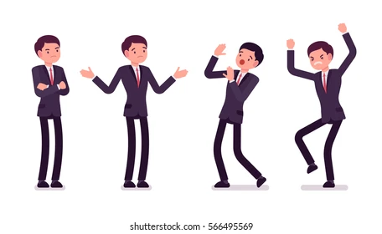
Improving Body Language - Tips
Keep appropriate distance
Touch only when appropriate
Take care of your appearance
Be aware - people may give false cues
Maintain eye contact
Smile genuinely

Slide 41

Body language- activity
Activity - Role Play
Notes:
Into pairs, act out difficult anticipated situations without uttering a word- one person acts and the other person guesses the problem. Take turns acting out situations.
What have you learnt from this exercise

Slide 42

Writing Skills
Writing skills include:
Grammar
Vocabulary
Spelling
Sentence construction
Structure
Research and accuracy
Clarity
Persuasiveness

Slide 43
Courtesy in writing
Courtesy in writing is achieved by the following.
Appropriateness of format for that kind of writing.
Appropriateness of content information
Appropriateness of tone: This is created by the word choice and choice of content information, i.e. what information is communicated versus what is left out. It also involves use the courtesy words please, thank you, excuse me and sorry as the situation requires.
Appropriateness of language use, ie. Word choice and expression that show respect and recognition of the audience. It also involves formality or informality of language used.
Expression of appropriate feeling according to the situation. For example, sympathy when someone suffers, good wishes when someone begins something new, and congratulation when someone achieves something.

Slide 44
PARAGRAPHING
A paragraph is a set of related sentences dealing with a single topic.
There is no rule about the length of a paragraph. It varies according to the need.
In a story or a novel, there are some long paragraphs and some short ones.
In a book that discussed concepts such as Economics, there may be long paragraphs.
In business letters, the paragraphs are short; in a report the paragraphs may be long.

Slide 45
A good paragraph has the following characteristics:
Topic sentence:
A topic sentence is a sentence that indicates in a general way what idea the paragraph is going to deal with. It includes the topic and a controlling idea. i.e. Shouldn't smoking in public places be made illegal?
Adequate development
Add supporting ideas to the topic sentence, to develop it fully and adequately. There should be 3 to 6 ideas to support the topic sentence.
Concluding/ clincher sentence.
The concluding sentence is the last sentence of the paragraph. It should leave the reader with something to think about. It can be written by restating the topic sentence in different words. i.e. I think it is in the interest of public health to make it illegal to smoke in public places.

Slide 46
ESSAY WRITING
Like a paragraph, an essay also has introduction in which the essay topic is first introduce, the body in which issues concerning the topic are discussed, and a conclusion which ties up your arguments about the topic.
The following are types of essays.
Descriptive
Explanatory
Narrative
Argumentative

Slide 47
FUNCTIONAL WRITING
Business correspondences are forms of communication that are used within an organization or from one organization to another.

Slide 48
Business letters
They include;
Letter of inquiry
Letter of complaint
Letter of appreciation
Letter of recommendation
Letter of apology

Slide 49
Memo
A memo (short for memorandum) is used only for communication within the organization. It may be from one person to another or to several persons.
Memos have the name of the organization, the title ‘Internal Memo, Ref. No., To., From., Date, Subject, Body, Name of Sender, Designation.,
The purpose of a memo may be:
To ask for information
To request decision or action
To convey information about action or decision

Slide 50
Circulars
Circulars are used for sending instructions and information about new procedures or policies to all branches of the organization. They are addressed impersonally like a memorandum "To all Branch Managers", or "To all Accounts section staff” for information and immediate action“
Contents: Name and Logo of organization, Ref. No., Date., Circular No., To., Regards., Body., Signature., Name., Designation., CC., Appendices (if any)

Slide 51
Public Notices
A notice is used when many people in the organization have to be given the same information.
It is the most common method of mass communication within an organization. A notice is short; the language is simple, and the type is large and well-spaced for easy reading. A notice is put up on the notice board. A copy may also be circulated among staff for signature. A notice is often called an office circular.
Notes:
Contents: Name and logo of the organisation., The title ‘Notice’., Content., Designation

Slide 52
Contd. functional writing examples
Electronic mail - Electronic mail, commonly shortened to “email,” is a communication method that uses electronic devices to deliver messages across computer networks.
Letter of application- Content: In the cover letter, you should include how you found out about the position, your primary reasons for being interested in the position, and how your specific qualifications (education, training, work-related experiences, and skills) meet the needs of the organization.

Slide 53
Curriculum Vitae/ Resume.
A résumé is a one-page or two-page summary of your training, skills, and accomplishments. Components are;
Personal details. Provide your name, address, and telephone number(s), email, gender, age, and optionally marital status, religion, nationality.
Job/career objective. Describe your goals in employment you are seeking.
Education. Begin with your highest degree and continue in reverse order.
Professional training. List any specialized training, courses, and so on.
Employment history. List both paid and unpaid work experience, beginning with the most recent. Include employment dates, primary job responsibilities, and accomplishments and awards.
Professional affiliations. List professional groups to which you belong and any offices you have held.
Special interests and skills. List interests and skills that are related to the job for which you are applying.
Referees. These are individuals who know your work, your abilities, and your character.
Notes:
As you construct your résumé, think in terms of how your education, training, skills, and
work experience can fit the requirements of the advertised job. Present only those skills and
accomplishments that show you can do the job. Emphasize your strengths throughout the
résumé, but always be truthful. Above all, your résumé should be written with the company
in mind—how can you satisfy the company’s employment needs?

Slide 54
SUMMARY WRITING
Summary means making a shorter version of a text which highlights the main contents of that text and which is in prose form. Importance
The study skill enables you to capture the key information in a spoken or written text for future reference.

Slide 55
Steps in summarization
Extract the main points onto a working space; you will then use these points to write your first draft.
If the draft is longer than intended, identify the unnecessary words and expressions and reframe your sentences. There could also be unnecessary points which you need to eliminate.
If the draft is too short, you are likely to have left out some important material which you need to include.
Write the final copy making sure it is of the intended length.

Slide 56
REPORT WRITING SKILLS
A report is a logical presentation of facts and information. It provides feedback to the managers on various aspects of the organization. A report presents information needed for reviewing and evaluating progress, for planning future course of action and for taking decisions.
Every organization has a system of routine periodical reporting on the progress and the status of different activities. Besides, management assigns some special studies for the purpose of taking decisions.
Special Reports may be written by an individual or by a group of persons to whom the task has been assigned. The report is submitted to the authority that assigned it.

Slide 57
Role of Reports
To review performance of a unit in an organisation
To keep a check on a continuing activity in an organisation
To plan for the future needs of the organisation
To survey the market needs for products or services of an organisation
To submit standardized information to the management of an organisation etc.

Slide 58
Types of Reports
Oral report
Written report
Management reports
Operation procedures
Production schedules
Maintenance, breakdown and accident reports
Entrepreneurship and trade reports
Internal memos

Slide 59
CONDUCTING MEETINGS AND MINUTE WRITING
Definition
Meetings are formal or informal gathering of members of an organisation or office with a purpose of discussing specific issues in an organisation.

Slide 60
Terminologies used in meetings
Agenda: a summary of business to be transacted at the meeting and are usually sent to members in a notification of meeting.
Quorum: the minimum number of members stipulated in the constitution or rules of an organisation to be enough to transact business of committee or group on behalf of others.
Quorum hitch: A situation where there aren’t enough members to transact business as required by the group standing order.
Standing orders: rules or constitution guiding meeting and conduct of business in an organisation.
In-attendance: Non-members of the organisation or committee who are attending a particular meeting.
Resolution: a decision made by the group meeting after discussing an agenda.
Adjournment: official ending of the meeting.
Amendment: any changes made to the minutes of the previous meeting especially at the stage of matters arising from the previous minutes.
Preliminaries: Activities preceding discussion of the day’s agenda, such as the chairperson opening the meeting and communication from the chair.
Communication from the chair: the chairperson’s opening remarks such as welcoming members, introducing the in-attendance if any, giving any reports that there may be and setting the tone of the meeting for discussion of the day’s agenda.

Slide 61

Role/Purpose of meetings

Slide 62
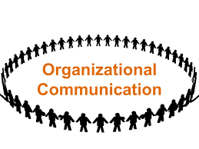
Organizational Communication
Refers to the communication that takes place between people who are working towards common goals within an organization.

Slide 63
Why learn Organizational Communication
At the end of this topic trainees should be able to;
Describe how information flows through an organization
Describe different types of how information flows
Define work place ethics and policies
Practice ethics when handling information
Practice professional etiquette for different types of communication in an organization

Slide 64
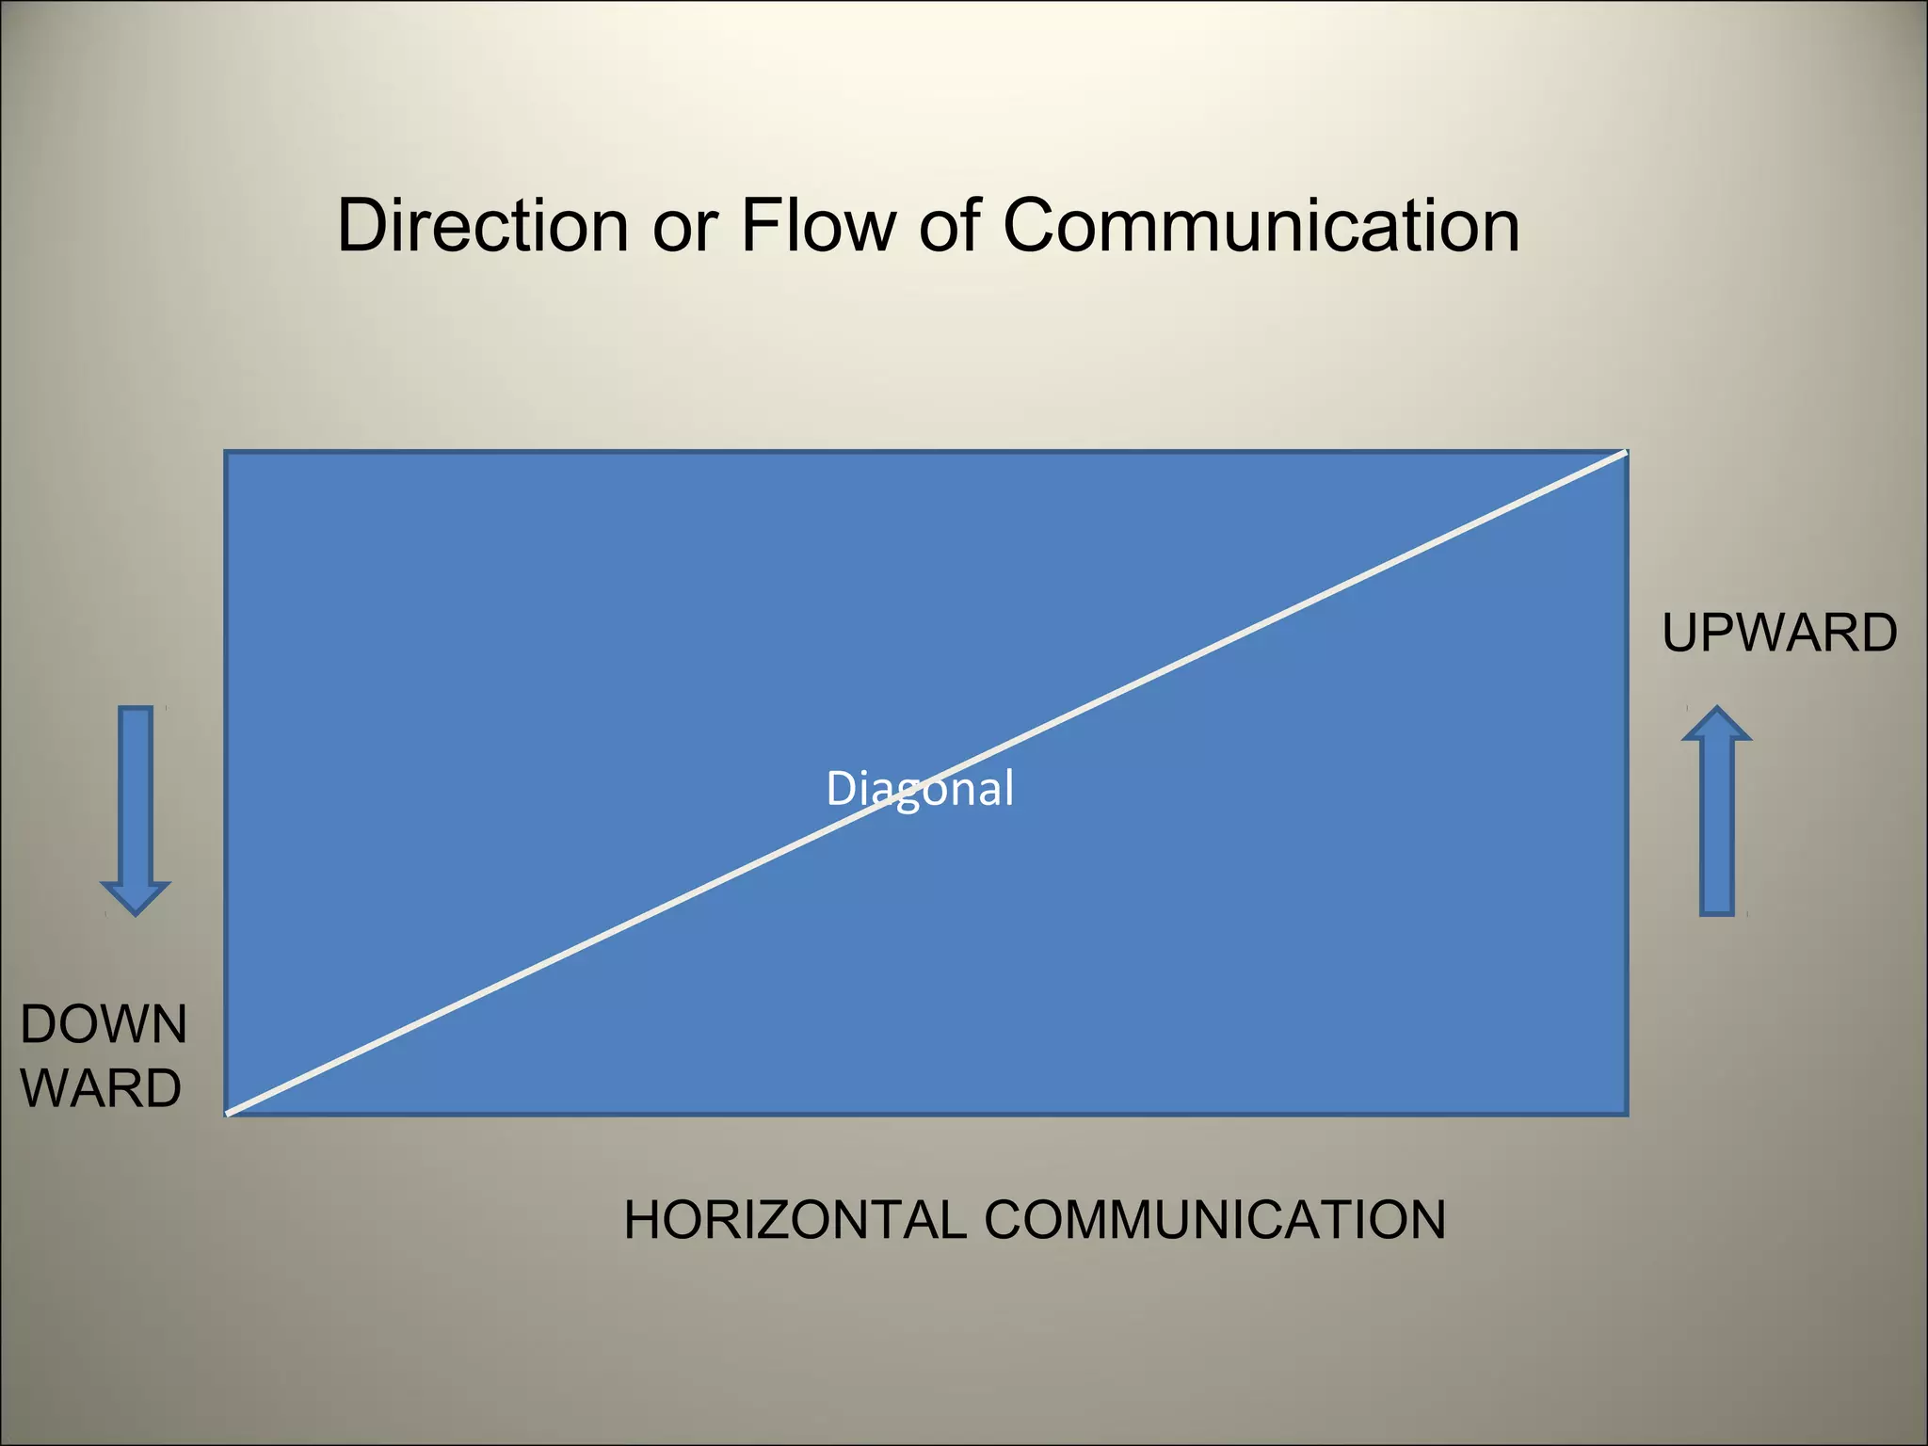
Organizational Flow of Information
Downward
Horizontal
Diagonal
Upward

Slide 65
Identify the flow?
General Manager
Head of Department
Supervisor
Supervisor
Supervisor
A
B
C

Slide 66
Types of communication
Formal
Informal

Slide 67
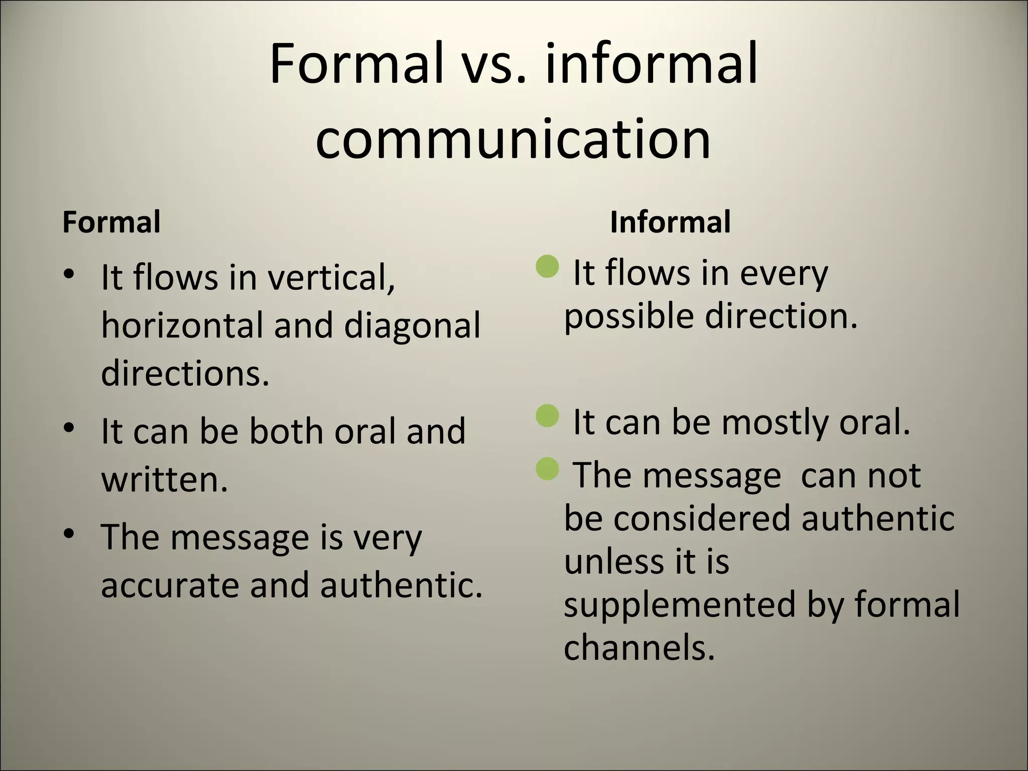
Differentiate between Formal & Informal Communication

Slide 68
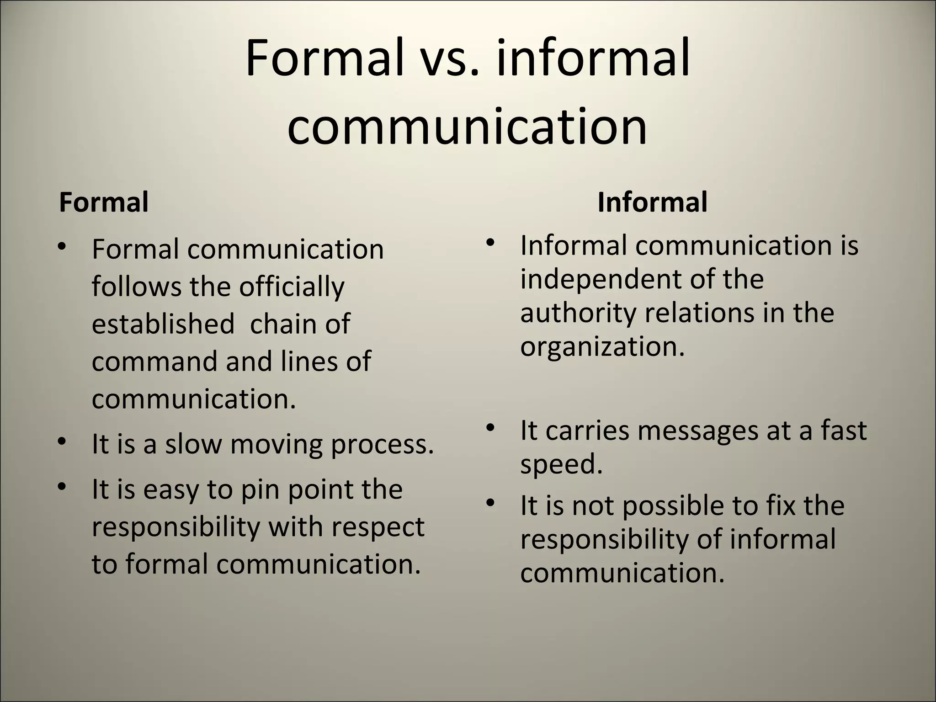
Formal vs. Informal

Slide 69
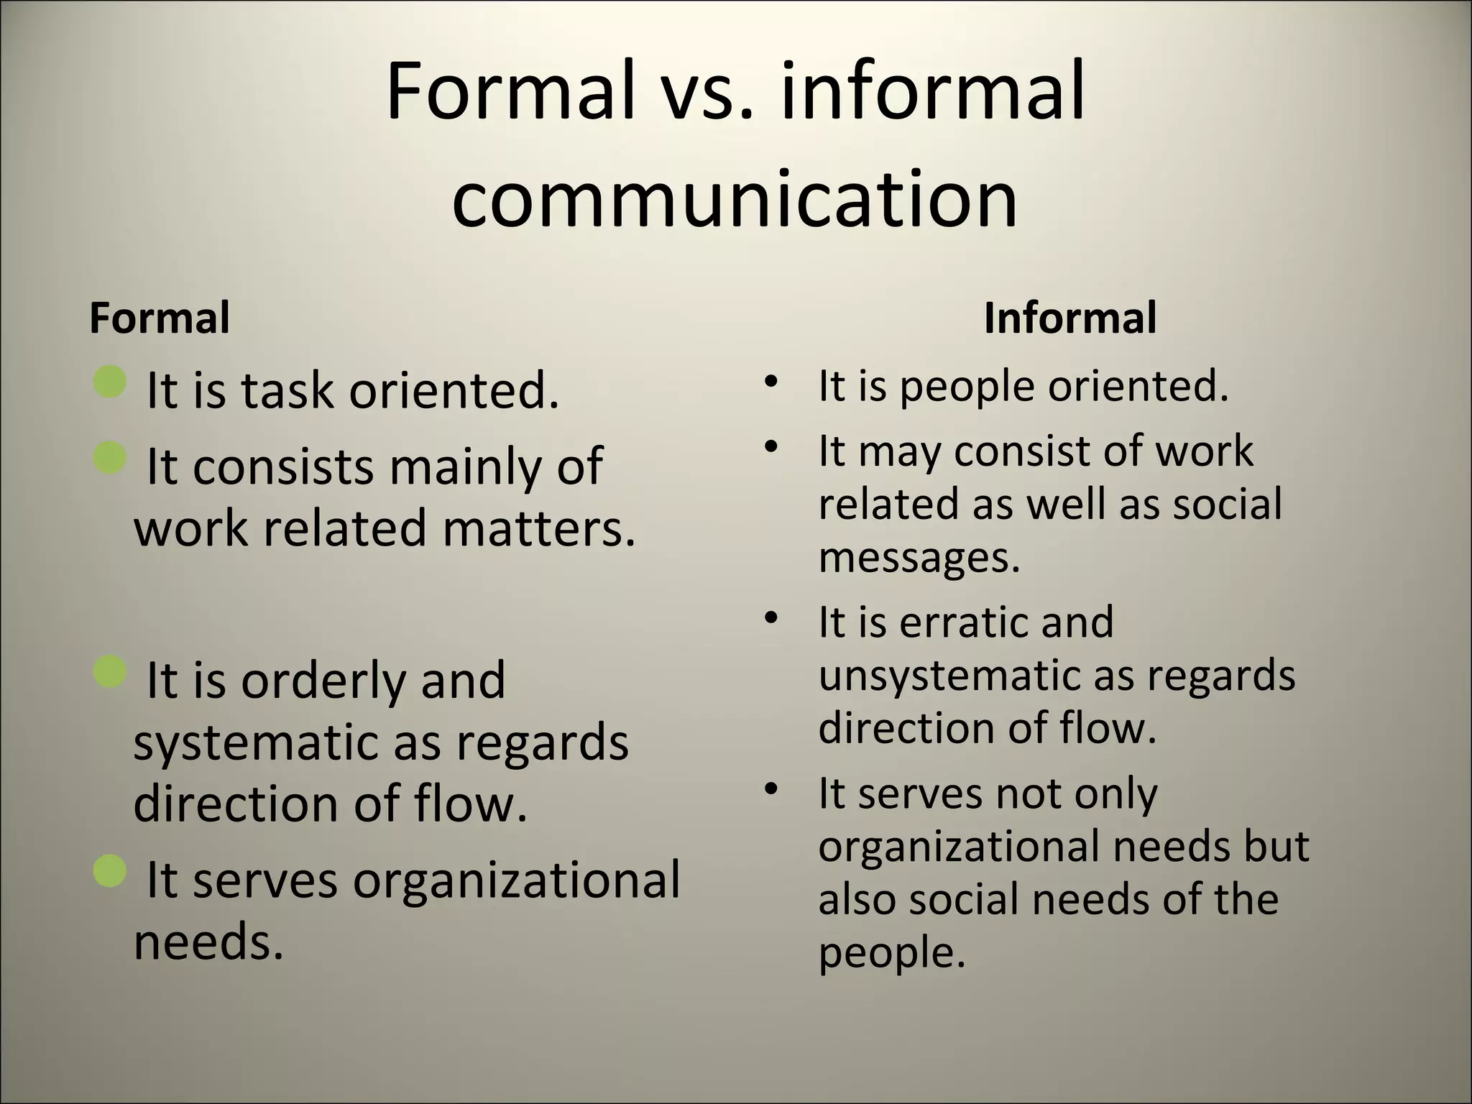
Last but not least

Slide 70
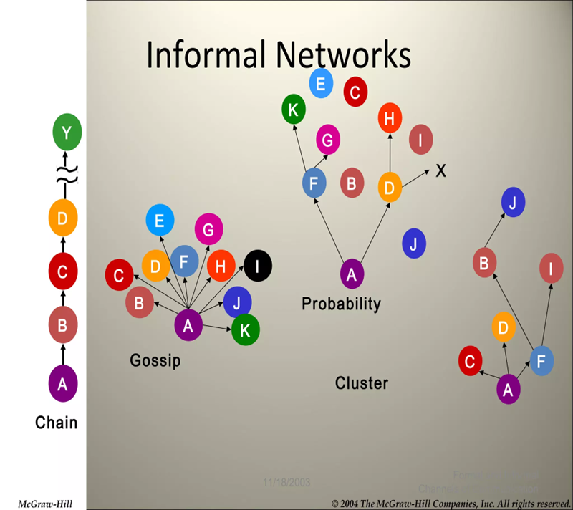
Informal Communication Networks
Straight chain
Gossip
Probability
Cluster

Slide 71

Advantages and Disadvantages of Formal and Informal Communication
Activity- Groupwork
Notes:
For each type of communication – discuss the pros and cons and one group member to do a presentation of your findings

Slide 72
Sources of Organizational Information
Internal sources of information are sources that are got within the organisation and tell how the organisation operates as a unit. They include staff records, minutes of meetings, financial records and sale records. These forms of information are got within the organisation
External sources of information in an organisation refers to the sources of information got outside the company ,they reflect how the organisation relates to the outside world. They include customers, distributors, suppliers and exchange rate articles.

Slide 73
Information Handling
'Data' is another word we can use for 'information'. There are many ways that we can report on data.
Data handling is the process of ensuring that research data is stored, archived or disposed off in a safe and secure manner during and after the conclusion of a research project.
Confidentiality and Need-to-Know basis
Social media and Technology
General Data Protection Regulation
Organization’s policies and procedures

Slide 74
The Process of Data Handling
The data handling process involves the following steps:
Step 1: Identifying the Problem. The first step in data handling is to clearly define and identify the problem or purpose.
Step 2: Collecting Data. The next step is to collect data relevant to the identified problem.
Step 3: Presenting Data. The collected data should be presented in a manner that is easily understandable. This can be achieved by organizing the data in tables, tally marks, and so on.
Step 4: Representing Data Graphically. The data can be visually represented using graphs and charts such as bar graphs and pie charts to make analysis and understanding easier.
Step 5: Analyzing Data. The data should undergo analysis to draw meaningful information from it, which can aid in taking further actions.
Step 6: Drawing Conclusions. After analyzing the data, solutions to the identified problem can be derived

Slide 75
How to ensure that data is accurate and reliable
Verify Data Sources: Identify where the sales data is stored or recorded (e.g., CRM system, sales reports, financial records).Check if there are multiple sources of data and ensure they are consistent.
Check Data Integrity: Examine the completeness and integrity of the data. Ensure there are no missing records or significant gaps. Look for any anomalies or outliers that may skew the overall picture.
Review Data Collection Methods: Understand how the data was collected and compiled. Ensure it was done using reliable methods and processes. Verify if there were any changes in data collection practices during the quarter that could affect comparability.
Validate Accuracy: Cross-check the data against other relevant metrics or historical data to verify its accuracy. Compare with previous quarters or similar periods to identify trends or deviations.
Consult with Stakeholders: Discuss the data with colleagues or departments involved in its collection or analysis. Seek feedback or insights to ensure a comprehensive understanding of the sales performance.

Slide 76
Contd. How to ensure that data is accurate and reliable
Data Analysis Tools: Utilize statistical analysis or data visualization tools to analyze the data. Apply appropriate methods to identify patterns, trends, or correlations.
Document Assumptions and Limitations: Document any assumptions made during the analysis process. Highlight any limitations or constraints of the data that could affect its interpretation.
Prepare Summary and Explanation: Summarize the findings and prepare a clear explanation of the key points. Provide context or background information that helps interpret the data accurately.
Final Quality Check: Conduct a final review to ensure all calculations are accurate and consistent. Double-check all figures and ensure they align with the narrative being presented.
Provide Documentation: Provide clear documentation or references for the data provided. Include sources, methodologies, and any relevant details that support the reliability of the information.

Slide 77
Types of workplace documents
Contracts
Documentation of bylaws
Non-disclosure agreement
Employment agreement
Business plan
Financial documents
Transactional documents
Compliance and regulatory documents
Business reports
Minutes of business meetings

Slide 78
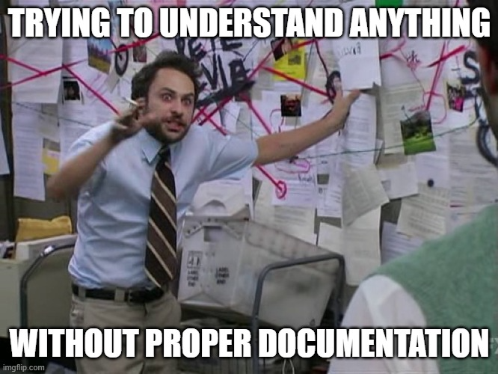
Purposes of workplace documents
Improves quality and process control
Eliminates duplicative work
Streamlines your hiring and onboarding processes
Keeps your teams on the same page
Improves training resources
Meets compliance regulations
Saves your teams time and energy

Slide 79
Methods used in filing forms and documents
Manual Filing System: A manual filing system involves physically storing paper records in file folders and filing cabinets.
Electronic Filing System: An electronic filing system involves storing electronic records on a computer or other electronic device, such as a hard drive or cloud storage system

Slide 80
Recording workplace data
Workplace data can be recorded on standard workplace forms in various ways, depending on the type of information being collected and the purpose of the form. Here are some common methods for recording workplace data on standard forms:
Manual Entry: One of the most common methods is manual entry, where employees or supervisors fill out forms by hand. This can include writing in information such as dates, times, quantities, or descriptions of incidents.
Digital Entry: With the increasing use of technology in the workplace, many organizations have transitioned to digital forms. Employees can enter data directly into electronic forms using computers, tablets, or smartphones. This method can help streamline the data collection process and reduce errors associated with manual entry.

Slide 81
Contd. Recording data
Checkboxes and Dropdown Menus: To standardize data collection and make it easier to analyze, forms often include checkboxes and dropdown menus for selecting predefined options. This can help ensure consistency in the data recorded and make it easier to aggregate and analyze.
Numeric Fields: Numeric fields are often used for recording quantitative data such as numbers of hours worked, quantities of items produced, or financial figures. These fields can help ensure that data is entered in a consistent format and facilitate calculations and analysis.
Text Fields: Text fields allow for the entry of free-form text, such as descriptions of incidents, comments, or other relevant information. These fields provide flexibility for capturing detailed information that may not fit into predefined categories.
Signatures and Timestamps: Many workplace forms require signatures and timestamps to verify the accuracy and authenticity of the data recorded. This can help establish accountability and provide a record of when the data was entered.
Attachments: Some forms may allow for the attachment of supporting documents, such as photos, scans, or other files. This can provide additional context and evidence to support the data recorded on the form.

Slide 82
Activity
Practice filling out different work documents
Objective is to familiarize the trainees with work documents.

Slide 83
Report writing
What is a work report?
A work report is a formal document that discusses information about a specific topic related to an aspect of your job.

Slide 84
Which of the two is a good report and why?
A.
‘Jeremy settled well last night and had dinner (fish and peas). Jeremy then did the crossword and went to bed at 8:30PM. Ensured that his room was tidy and there were no obstacles. Jeremy slept through the night and woke up at 6:30AM.’
B.
‘ Jeremy settled well last night and had dinner (fish and peas). Jeremy then did the crossword and went to bed at 8:30PM Jeremy slept through the night, he said at dinner the new cream is causing him to itch.’

Slide 85
Tips on Report Writing
Always make sure you have the correct time and date.
Be objective and do not include any emotionally charged language
Avoid providing diagnoses for someone; instead, describe the observed behaviors.
Avoid exaggerating or embellishing.
Write as if the individual may read the report.
Be concise

Slide 86
What is Workplace Etiquette?
Workplace etiquette means the socially acceptable ways that we interact with one another and behave in our workplace.

Slide 87
What we will discuss
Office etiquette
Meeting etiquette
Email etiquette
Phone etiquette
Message etiquette

Slide 88

Office etiquette
Activity – Group discussion

Slide 89

Meeting etiquette
Arrive on time
Listen carefully
Take notes
Be focused
Ask questions

Slide 90

Email etiquette
Respond promptly
Include a salutation and a closing remark.
Be concise and to the point
Check for proper spelling, grammar and punctuation
Write clear and subject line
“Reply to all” sparingly

Slide 91
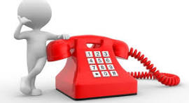
Phone etiquette
Answer the call within 3 rings
Immediately introduce and greet
Be audible
Use proper language and tone
Ask before putting someone on hold, speaker or transferring a call
Be patient and listen keenly
Return missed calls within reasonable time

Slide 92
Etiquette Summary
Maintain good hygiene and proper sanitation
Punctuality
Maintain professional boundaries
Show respect for others
Dress appropriately
Exercise professionalism
Be trustworthy
Communicate effectively
Take notes

Slide 93

Organizational Policy
This is a set of rules, responsibilities, processes, and timelines that govern the behavior of carious entities connected with an organization

Slide 94
Healthcare policies
Patient care policies
Workplace health and safety policies
Information security policies
Data privacy and IT security
Drug handling
Administrative and HR policies
Infectious disease policies
Code of ethics
Social media policies

Slide 95
Questioning Techniques
“Garbage in, garbage out,”
If you ask the wrong questions, you'll probably get the wrong answer, or at least not quite what you're hoping for.

Slide 96
Tips on Questioning Techniques
Closed questions are useful when you need a to-the-point answer, whereas
Open questions are good for extracting more detailed responses.
Funnel questions are a way to extract more detail gradually. This technique is a good way to prompt memories or deeper thinking.
Probing questions help you gain detail and clarity.
Leading questions are a good technique if you're trying to persuade someone, but they can leave the other person feeling they have little or no choice.
Rhetorical questions encourage reflection and are another useful persuasion technique.
Asking the right kind of questions can help you in all sorts of situations, like coaching or defusing tension and anger. They help you to learn about people, communicate more clearly, and build relationships.

Slide 97
Probing
An effective probing question helps to get a person to talk about their personal opinions and feelings, and promotes critical thinking. Probing questions are typically open-ended, meaning there is more than just one response.

Slide 98
Probing matrix
Lower Higher
 | Is | Did | Can | Would | Will | Might
What
Where
When
Who
Why
How

Slide 99

Probing Technique
Activity- Role play
Objective is to engage trainees in interactive activities where they can practice framing and asking questions
Notes:
Invite one trainee to volunteer and leave the room while the other trainees decide something they would wish to learn about the volunteer i.e. where the person last went on holiday. Invite the volunteer back and ask them to make a statement about what they wish to know. The group can then ask open questions to try and learn but can only ask a question based on the last thing the volunteer said

Slide 100
Telephone Handling
Preparing for the Call: every successful telephone conversation starts before the handset is even lifted.
Here’s how you can lay the groundwork for a productive call:

Slide 101

Phone Skills
Before Dialing
Know your purpose: Be clear on why you are making the call. Is it to provide information, solve a problem, or make a decision? This clarity will guide the conversation.
Research: Gather all necessary information about the topic and the person you are calling. Being well-informed instills confidence and facilitates a smoother interaction.
Plan your call: Outline the points you need to cover and questions you need to ask. This keeps the conversation on track and efficient.
Environment: Ensure you are in a quiet place where you can speak and listen without distractions.

Slide 102
Techniques for a Positive and Productive Interaction
During the Call:
Professional Greeting: Start with a courteous greeting and self-identification. First impressions matter, even on the phone.
Clear Speech: Speak clearly and at an even pace.
Active Listening: Pay attention to the caller’s words and tone. Active listening can help you respond more effectively.
Empathy: Especially with adults, showing understanding and patience can help in building rapport and trust.
Stay Focused: Keep the conversation on topic. If the call strays, gently steer it back to the main points.
Take Notes: Jot down important points and follow-up actions. This will help you remember and act on them after the call ends.

Slide 103
Ensuring Continuity and Closure
After the Call
Summarize: Before ending the call, summarize the key points and any agreed-upon actions to ensure mutual understanding.
Express Gratitude: Thank the person for their time. Courtesy goes a long way in maintaining a positive relationship.
Action Items: Follow through on any commitments you made during the call promptly.
Record Keeping: Keep notes or a call log, especially if the call involved important decisions or educational instructions.
Feedback: If appropriate, invite feedback on the call to improve future communications.

Slide 104
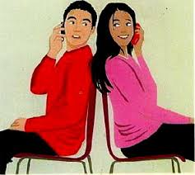
Demonstrate phone skills
Activity- Role play
Notes:
Take a pair of cards: One of you takes card A and one of you card B. Sit back to back and act out the telephone conversation. Partner A calls partner B. Then take a new pair of cards and swap roles.
Each pair will conduct two interviews taking turns as the caller and receiver. Allow two minutes for each person to assume both roles.
Discuss and critique the experience with the larger group.

Slide 105

Workplace discussions
What are some of the work place discussions you know?

Slide 106
How to establish work boundaries
Activity- Role play
Objective is to provide a safe space for trainees to practice assertiveness and strengthen their boundary-setting skills.
Notes:
Ask trainees to take up roles (colleague- colleague and colleague – manager) in pairs and strike a conversation on setting boundaries at work. “ Don't just explain what your boundaries are but also why you need them. Be honest so that your manager and colleagues understand your perspective. Also, define your terms. For instance, if you don't want to be contacted on vacation unless it's urgent, outline what constitutes an emergency.”

Slide 107
Lead workplace discussion
Activity- Roleplay
Coordination meetings
Toolbox discussion
Peer-to-peer discussion

Slide 108
Coordination meetings
Meetings can be classified on the basis of whether they are convened formally or informally.
Informal meetings: meetings called at short notice either by means of telephone, by memorandum or by word of mouth to discuss matters which arise suddenly. They normally don’t have an agenda communicated prior to the meeting.
Formal meetings: meetings held after the people concerned have been notified in writing earlier. Notification of meeting is normally contains agenda for the meeting.

Slide 109
Responsibilities of Participants
Contributing to the discussion of the agenda,
Putting the executive to task to explain issues pertaining to the agenda,
Passing resolutions on policies and decisions,
Implementing decision of meetings as are assigned or required.

Slide 110
Golden rules of meeting management
Select participants with care to ensure that all who need to be involved are, but that people who are not required can be spared the time.
Be prepared and ensure participants can be prepared by providing relevant documents in advance.
Stick to a schedule.
Stay on topic.
Don't hold unnecessary meetings.
Wrap-up meetings with a clear statement of the next steps and who is to take them.

Slide 111
Toolbox discussions
Involves constructive contributions made during workplace meetings on issues like production, quality and safety.

Slide 112

Coordination meetings
Activity- Role play

Slide 113
Soliciting response/feedback
This is crucial for fostering a culture of open communication and continuous improvement. Through the input of others, employees gain a more holistic awareness of their individual strengths and weaknesses, learn to address bad work habits, and discover areas for growth and development.

Slide 114
Suggestions for effective participation in meetings
Never fail to do homework. Study every item on the agenda, collect information and gather points of view for each item. Any papers distributed with the agenda must be read thoroughly.
Keep an open mind. However well-prepared you may be, there is a possibility that you may be wrong. Be prepared to learn and correct any mistake in thinking or information.
Do not disturb other participants or yourself by talking on the side or shuffling papers.
Have a sporting spirit. If your idea/suggestion is defeated in the discussion, be graceful and thank others for helping you to clarify your ideas.
Show interest in what others say. When someone makes a good point, show appreciation even if it demolishes your point.
Never personalize a difference of opinion. If it is necessary to disagree with something that is said, first re-state or summarize it and then explain why you disagree.

Slide 115
Contd.
Speak up if you have something to say, especially on a topic on which you have knowledge. Willingness to contribute and share is necessary. But keep your comments short and precise. There is no need to make a lengthy speech to make an impression.
Do not be carried away or swayed by emotions. Problems cannot be solved by anger, jealousy, revengefulness or spite. Willingness to examine the ideas presented will be more useful.
Be a good listener. You will learn a great deal about matters and about human behavior if you listen carefully and intelligently.
Be courteous at all times. Your meeting manners must be at least as good as your social manners when you are the host, or a guest in someone's house.

Slide 116

Identify and communicate issues arising in the workplace
Introduction

Slide 117
Topic Objectives
By the end of this topic trainees should be able to;
Identify arising issues and problems
Organize information regarding problems and issues coherently to ensure clear and effective
communication
Initiate dialogue with appropriate staff/ personnel
Raise arising communication problems and issues

Slide 118
Communication methods
Here are several methods and mediums used for communication in the modern workplace:
Video messaging
Direct messaging
Email
In-person
Notes:
Video messaging
Video messaging allows for employees or teams anywhere across the globe to instantly connect. Organizations use video messaging applications for better communication with long-distance or remote employees. Because the applications show individuals through video, they're often preferred over phone calls. If you must share sensitive information with a distant individual, video conferencing provides a more personal and private meeting in comparison to a phone call.Direct messaging
Some organizations provide instant messaging applications to their employees. These applications allow individuals to directly message each other throughout the day, making organizational communication easier and more efficient. Most of these applications allow for both one-on-one communication and group conversation. Additionally, these applications provide real-time conversations without the delay of email replies.Email
Email involves the sending and receiving of communication through a virtual inbox. Most organizations use email for both internal and external communication. Once sent, you cannot edit or alter emails in any way, necessitating thorough editing on each message. Many email applications come with additional tools such as shared meeting calendars, address books and more that further support communicative efforts.In-person
In-person communication involves speaking with one or more individuals face-to-face. Depending on the context, in-person communication often holds more value than digital communication. For example, when speaking in-person, no one hides behind a computer screen. This often encourages more honest communication. Additionally, through in-person communication, all parties communicate with each other directly without delay or the reliance of technology.

Slide 119
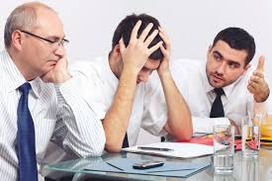
Identification of problems and issues
Group discussion activity- How can we recognize signs of potential issues at work?
Notes:
Ask participants to discuss and a representative to present their findings.
List down all points raised and summarize.

Slide 120
What are the most effective ways to identify workplace problems?
Listen to feedback
Observe and measure
Ask questions
Use tools and techniques
Review and update
Notes:
1. One of the best sources of information about workplace problems is feedback from your customers, employees, and stakeholders.
2. Another way to identify workplace problems is to observe and measure your work environment and outcomes. Observation can help you see how your team, department, or organization operates, communicates, and collaborate
3. A third way to identify workplace problems is to ask questions. Questions can help you clarify, explore, and challenge your assumptions, perceptions, and opinions. You can ask questions to yourself, your team, your manager, or your experts and seek different perspectives, insights, and evidence.
4. fourth way to identify workplace problems is to use tools and techniques that can help you organize, analyze, and visualize data and information. Tools and techniques can help you identify the root causes, effects, and scope of problems and generate possible solutions. Some examples of tools and techniques are SWOT analysis, fishbone diagram, Pareto chart, brainstorming, mind mapping, or decision matrix
5. fifth way to identify workplace problems is to review and update your processes, policies, and practices regularly. Review and update can help you evaluate your current situation, identify gaps, opportunities, or risks, and implement changes or improvements. You can review and update your processes, policies, and practices by conducting audits, assessments, or reviews, or by applying feedback loops, continuous improvement, or change management principles.

Slide 121

Signs of potential issues
Activity- Role play
Notes:
Changes in employee behavior, Decreased productivity, Increased absenteeism, interpersonal conflicts etc.

Slide 122
Indicators of issues at work
Frequent Employee Departures
Overbearing Supervision and Limited Independence
Breakdown in Communication
Constant Negativity and Rumor-Mongering
Excessive Workload and Employee Burnout
Limited Opportunities for Growth
Discrimination and Intimidation.

Slide 123
Feedback mechanisms at work
Activity- Group discussion
What are the different feedback mechanisms can be used to gather information about issues?
Notes:
Allow participants to discuss and later have a presentation.
List all points on the white board and summarize.

Slide 124
Employee Feedback Mechanisms
Surveys: Performance Review
Performance reviews are typically conducted once per year.
One-on-One Meetings
Group Discussions
360-degree evaluation:
Notes:
Surveys are one of the most popular methods for gathering employee feedback. They can be used to collect data on a variety of topics, from job satisfaction to overall engagement levels. Surveys provide organizations with valuable insights that can be used to improve the workplace and make employees happier.
During a performance review, an employer will sit down with employees and discuss their performance over the past year. The employer will also give the employee feedback on their performance. Performance reviews give organizations the chance to identify areas where employees need improvement and offer appreciation.
One-on-one meetings between managers and employees are another great way to collect feedback. These meetings provide an opportunity to employees to share their thoughts openly as it builds trust. One-on-one meetings also give managers the chance to get to know their employees better and build strong relationships.
Group discussions are another effective way to gather employee feedback. This technique allows employees to share their thoughts and feelings about their work in a collaborative form. This technique can be used in a variety of settings, such as team meetings, departmental meetings, or all-hands meetings. These discussions can be used to collect data on a variety of topics, from team dynamics to overall job satisfaction levels. Group discussions also provide employees with an opportunity to share their thoughts and ideas with each other,
Exit interviews: They are conducted when an employee leaves the organization, either voluntarily or involuntarily. During an exit interview, the departing employee is asked for feedback on their experience in the organization. This type of feedback can be very valuable because it can help employers identify problems or factors within the organization that could be one of the causes of their exit.
A 360-degree evaluation is conducted by collecting feedback from multiple sources, including the employee’s supervisor, coworkers, and subordinates. Such type of evaluation technique can help to get a more well-rounded picture of an employee’s performance.

Slide 125
Workplace problems and some suggestions on how to solve them:
Low employee motivation-set up meetings with employees to learn if they're feeling unappreciated, overworked or experiencing personal problems at home. Consider a personal conversation with an employee to reach the direct cause of their low motivation. You can then offer solutions that address direct causes.

Slide 126
CONT 1.
Poor company culture-Culture encompasses the company's values, how it views employees and how employees support each other. Companies can build a stronger company culture by asking for employee feedback, creating more identifiable company values and building cooperative teams through collaborative projects and positive reinforcement.

Slide 127
CONT 2.
Lack of work-life balance for employees- Companies can focus on improving work-life balance by offering more time off, flexible schedules and paid holidays. They might stress the importance of work-life balance and create more manageable quotas for employees.

Slide 128
CONT 3.
Inflexible schedules- Inflexible schedules can become problematic because they don't allow employees to take time off when necessary or adjust their schedules to meet personal needs. Businesses can solve this problem by creating a better schedule for each team and implementing more coverage for employees taking time off. This can mean hiring temporary employees or contractors to meet quota needs and offering different scheduling options.

Slide 129
CONT 4.
Insufficient training- Insufficient training typically occurs when a company requires a better onboarding process that focuses on providing direct training from experienced individuals. To address an insufficient training programme, employers can create an onboarding process that pairs new employees with experienced trainers and connects them to a network of experts or peers who can answer their questions.

Slide 130
CONT 5.
Lack of proper tools or equipment- Businesses can address this common work problem by reviewing their equipment and production needs frequently to ensure it matches modern standards. Companies can also ask their employees for any suggestions for tools and equipment that might help them do their jobs more efficiently

Slide 131
Workplace Communication barriers
Lack of clarity and context
Information overload
Hierarchy and power dynamics
Cultural differences and language barriers
Poor communication channels
Noise and distractions
Emotional factors
Notes:
Lack of clarity and context
What it is: Messages that are unclear, ambiguous, or lacking necessary context can lead to misunderstandings and misinterpretations
What to watch out for: Unclear expectations, vague instructions, or incomplete information
Information overload
What it is: Excessive information or communication overload can overwhelm employees and make it challenging to prioritize or absorb essential messages
What to watch out for: Decreased attention and focus or a failure to retain information due to too many emails, meetings, or notifications
Hierarchy and power dynamics
What it is: Hierarchical structures and power differentials within organizations can create barriers to open communication
What to watch out for: Employees who are reluctant to voice opinions, provide feedback, or raise concerns to higher-ranking individuals, fearing repercussions or backlash
Cultural differences and language barriers
What it is: Differences in communication styles, norms, values, and language proficiency may lead to misunderstandings, misinterpretations, or cultural insensitivity
What to watch out for: Frequent misunderstandings, complaints about lack of clarity, and disagreements about how to interpret a message, as well as stereotyping, ostracization, or other ethnocentric behaviors
Poor communication channels
What it is: Inadequate (or too many) communication channels or tools can hinder the flow of information within the organization, leading to delays, misunderstandings, and inefficiencies
What to watch out for: Team members frequently using the wrong channels to share information or insights and vital information being lost or delayed because of how it is shared
Noise and distractions
What it is: Environmental factors such as background noise, interruptions, or visual distractions in the workplace can disrupt communication and impair concentration
What to watch out for: Complaints about difficulty concentrating or completing work
Emotional factors
What it is: Emotional factors such as stress, anxiety, frustration, or conflict can impact listening skills, cloud judgment, and hinder empathy and understanding among team members
What to watch out for: A lack of employee feedback or engagement, absenteeism, tense body language, or a lack of collaboration between team members or teams

Slide 132

Recap: Think-pair-shares activity
Notes:
Gets students talking to each other about the concept you’re wrapping up, even allowing for the sharing of new perspectives. Have your students spend a few silent minutes thinking about an aspect of the topic you learned (or the topic as a whole), and then pair them with other students to discuss any relevant angles, pros and cons, or strategies.

Slide 133


